Slide 1
Life Science Chapter 10
Intro to Plants

Slide 2
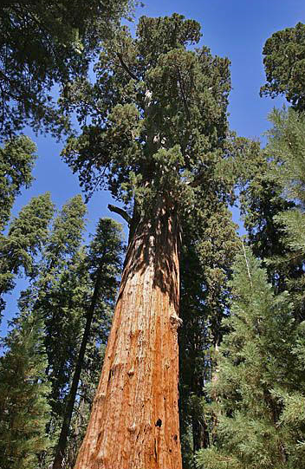
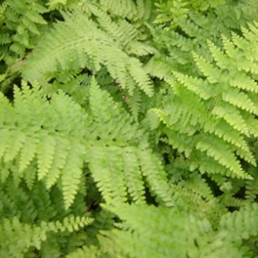
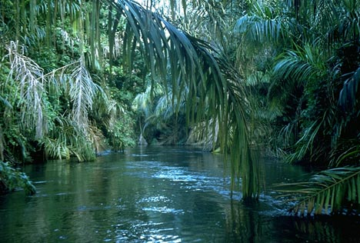
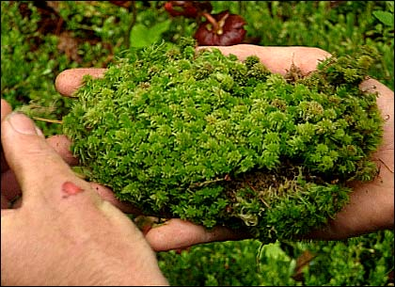
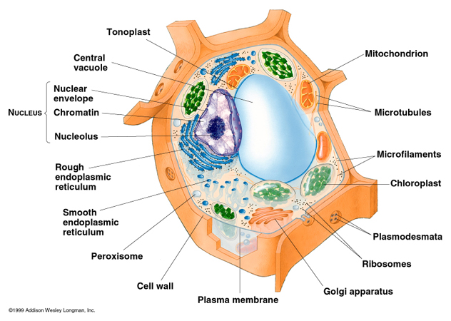
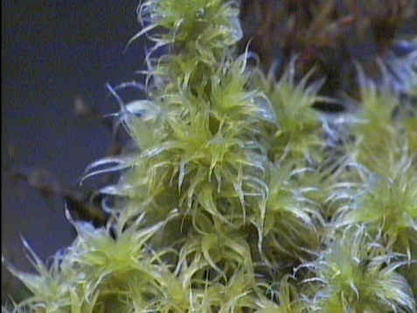
What is a Plant?
They are autotrophic multicellular eukaryotes
Their cells possess a cell wall made of cellulose, have no centrioles, contain a “gigundo” water vacuole & chloroplasts.
6CO₂ + 6H₂O → C₆H₁₂O₆ + 6O₂

Slide 3
Living on Land … what is required?
Be able to obtain water and other materials from the environment
Retain water - Reduce water loss thru transpiration
Transport materials throughout plant
Support their bodies
Reproduce successfully
Ding-a-ling!!

Slide 4
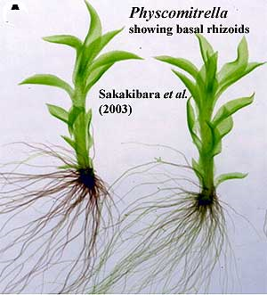
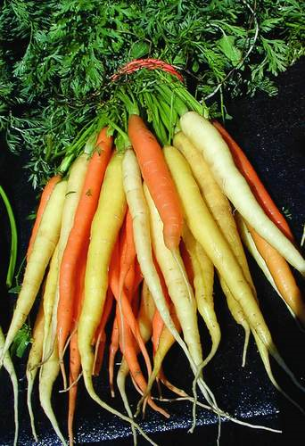
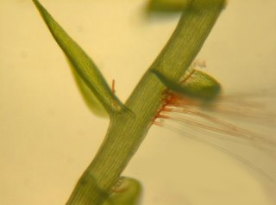
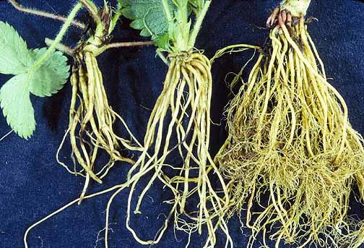
Be able to obtain water
Aquatic plants are surrounded by water, but to live on land they must be able to pickup water from the environment
Bryophytes use rhizoids & Tracheophytes use true roots

Slide 5
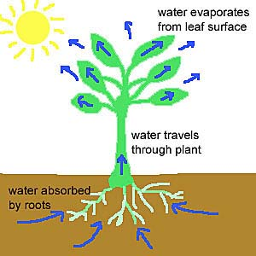
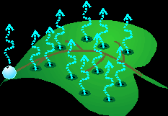
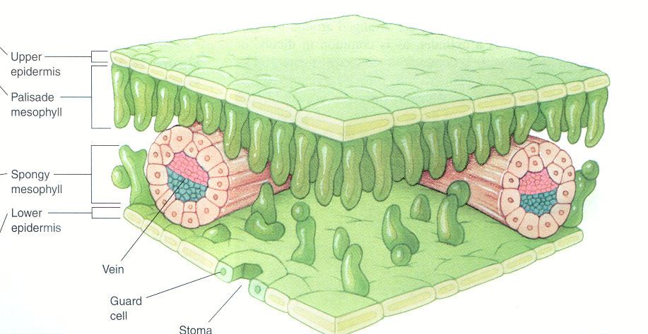
Retain Water
Plants lose water by a process called transpiration
Water taken into the plant by the roots is pumped throughout the plant and escapes through leaf stomata.
Waxy leaf covering – cuticle
Stomata – protected by Guard Cells that open & close preventing water loss during dry times
Desert plants w/ needles or leathery leaves

Slide 6
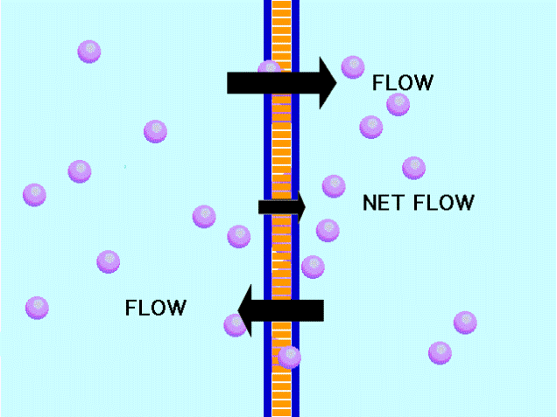
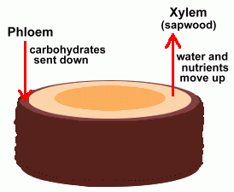
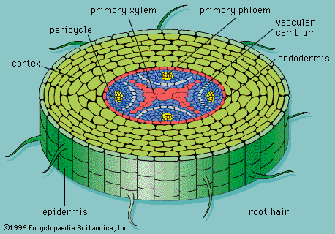
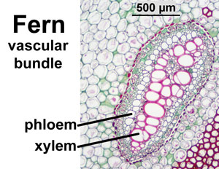
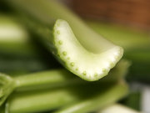
Transport materials
Bryophytes transport materials by diffusion / osmosis
Diffusion: Moving material from high [ ] to low [ ] .
Osmosis: Moving water from high [ ] to low [ ] thru semi permeable membrane
Tracheophytes transport w/ vascular tissue
Phloem: transports food from leaves down to the roots
Cambium: produces new phloem & xylem cells
Xylem: moves water & minerals from roots up to the leaves

Slide 7
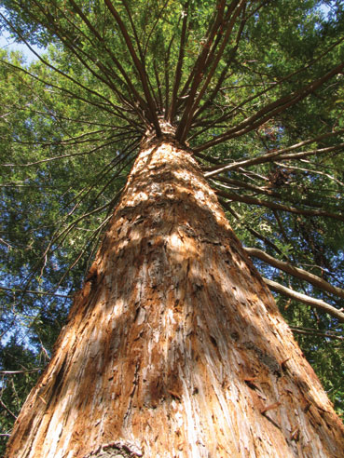
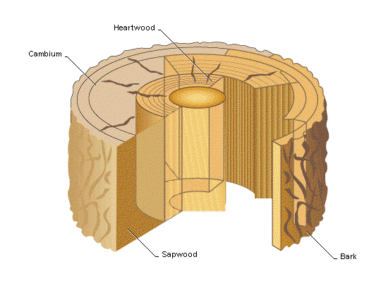
Support their bodies
Algae & water plants are supported by the water they live in and require little structural support
Life on land requires the plant to be able to support itself and rise above the other competing organisms
Vascular tissue supports in Tracheophytes allowing
them to grow over 300 feet tall
Bryophytes w/out vascular tissue and usually
cannot grow more than a few inches tall

Slide 8
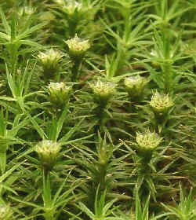
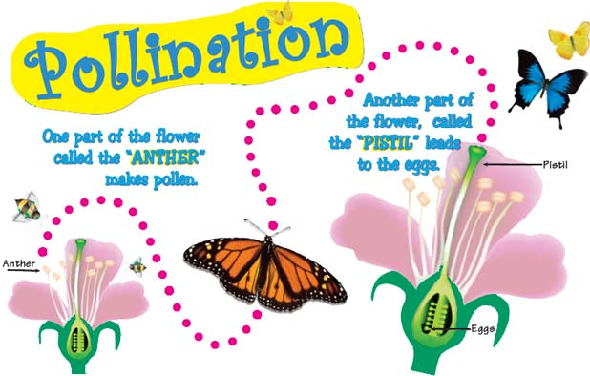
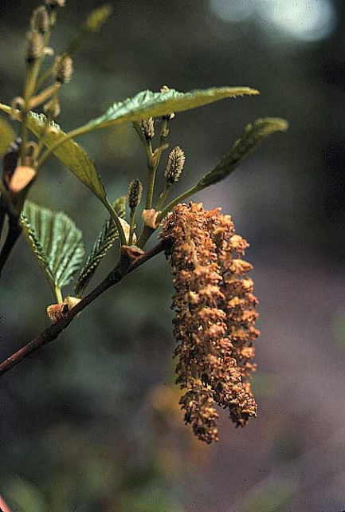
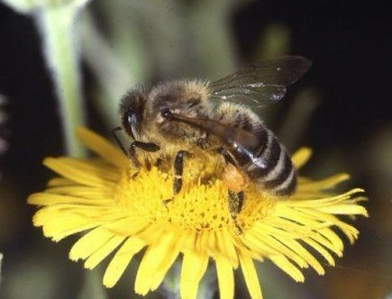
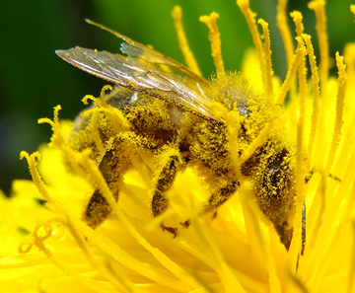
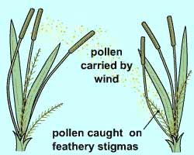
Reproduce successfully
For fertilization to occur male & female gametes must come together
Aquatic plants use the water itself to transport sperm, eggs, spores
Terrestrial plants needed to develop a new way to get the gametes together
Pollination by wind, insects, etc. etc.

Slide 9
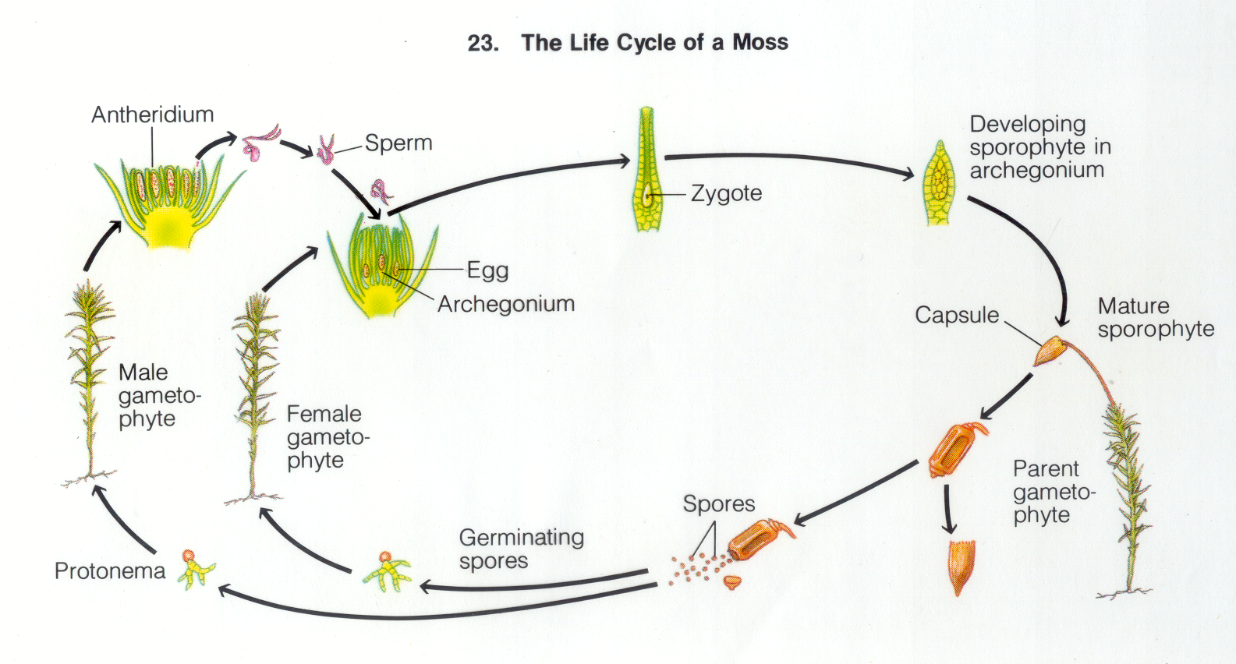
Alternation of generations
Life cycle of a plant has a haploid stage and a diploid stage
Haploid stage is called the gametophyte generation
Diploid is the sporophyte generation
In most Bryophytes (mosses, hornworts & liverworts)
the main plant is in the gametophyte stage. Male gametophytes produce sperm from the antheridium, the female gametophyte produce eggs in the archegonium.
When fertilization takes place, the new sporophyte stage grows out the top of the archegonium, produces a capsule that makes hundreds of spores to be released.
Diploid - 2N
Haploid - N

Slide 10
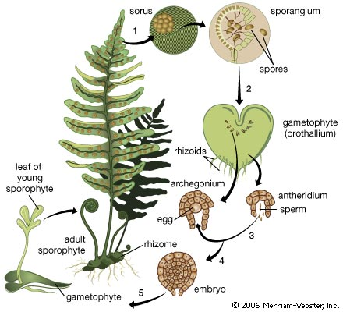
Alternation of Generations
Life cycle of a plant has a haploid stage and a diploid stage
Haploid stage is called the gametophyte generation
Diploid is the sporophyte generation
In Primitive Tracheophytes (Ferns):
the familiar large frond plant is the sporophyte (spore producing). These spores grow into tiny inconspicuous mat-like plants which is the gametophyte stage.
Gametophyte produces both sperm & egg. When fertilization occurs, the new sporophyte grows off of the gametophyte
As the sporophyte grows it over powers the tiny gametophyte stage

Slide 11
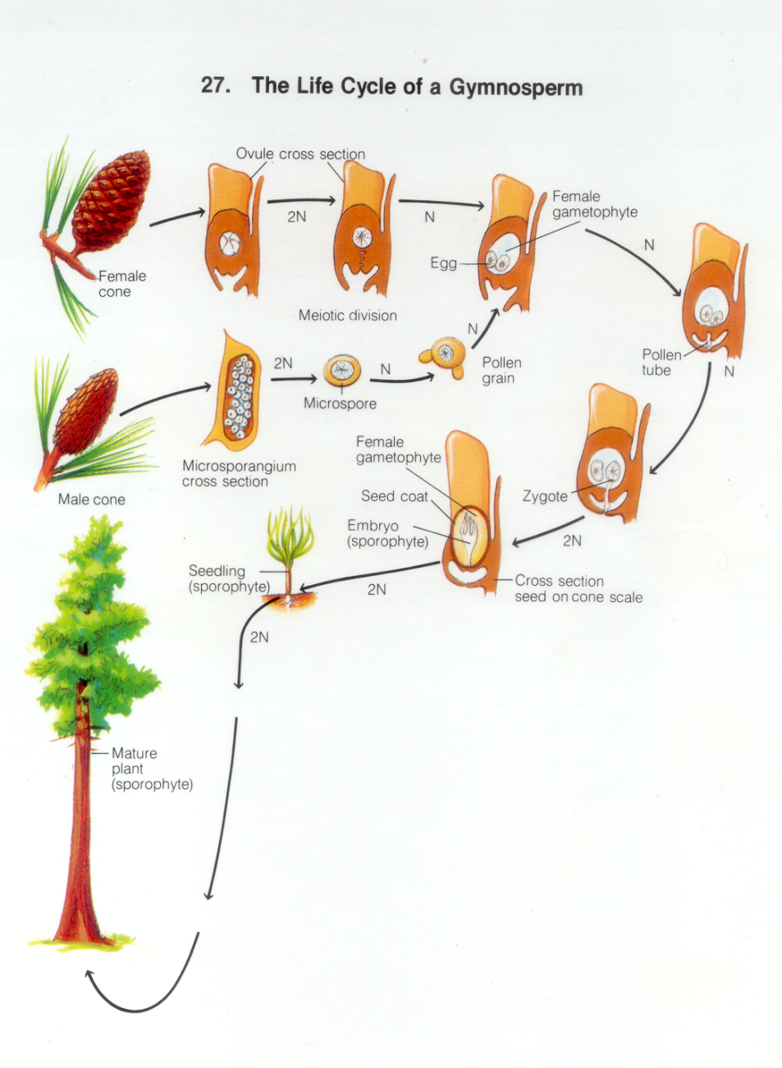
Alternation of generations
In advanced Tracheophytes
(Gymnosperms & Angiosperms) the main plant 99% of its life cycle is in the diploid (2N) sporophyte generation.
The haploid (N) gametophyte is only present inside the seed itself.

Slide 12
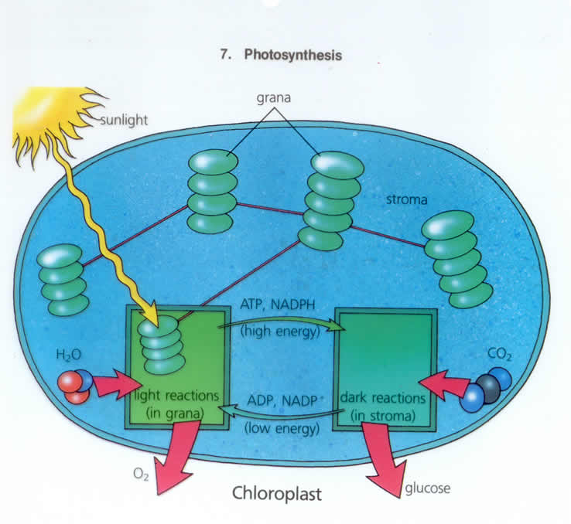
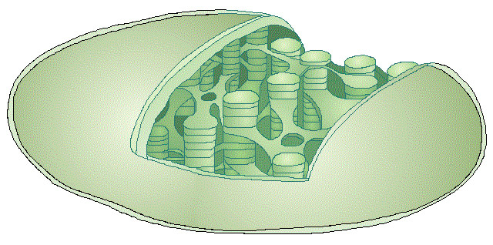
Photosynthesis:
Converts sunlight energy into food for the plant.
Takes place in the chloroplast
Has a light (grana) & dark reaction (stroma)
6CO₂ + 6H₂O → C₆H₁₂O₆ + 6O₂
Remember the chloroplast has two main parts:
The grana are composed of stacks of thykaloids & the space between grana is the stroma

Slide 13
Photosynthesis: overall reaction
6CO₂ + 6H₂O → C₆H₁₂O₆ + 6O₂
Reactants: carbon dioxide & water
In the presence of sunlight & chlorophyll
Yield
Products: Glucose and oxygen

Slide 14
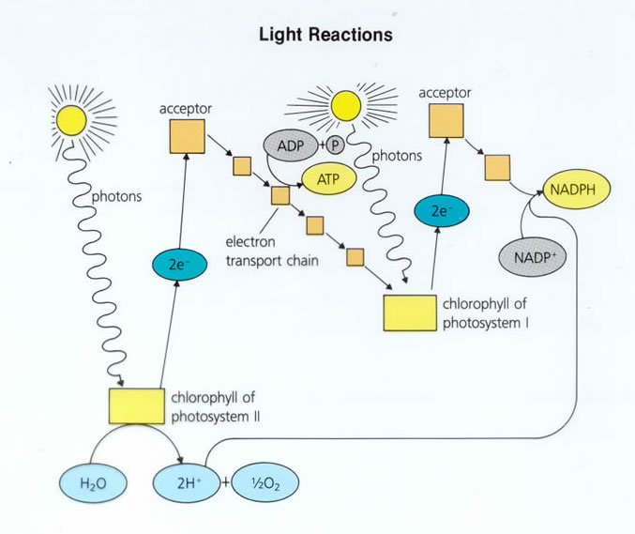
Light Reaction – Takes place in the Grana
Requires sunlight
Photons from sun & water, H₂0, from the plant come into the grana.
Chlorophyll kicks off an electron from the splitting of H₂O into hydrogen & Oxygen.
ADP (low energy) is converted into ATP (high energy)
NADP⁺ (low energy) is converted into NADPH (high energy)
In summary:
Photons, water, ADP & NADP⁺ in…
Oxygen, ATP & NADPH out

Slide 15
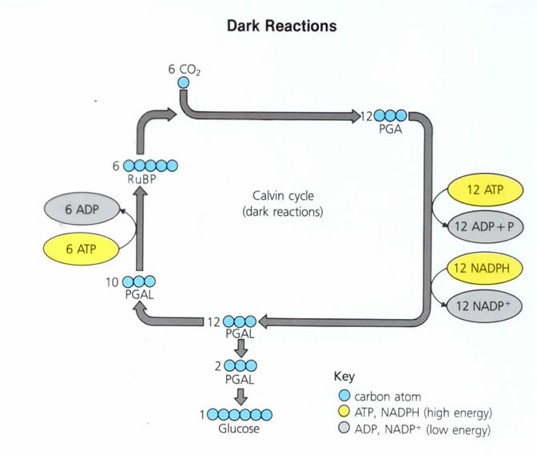
Dark Reaction – Takes place in the Stroma
Takes place day or night, no sun required
ATP (high energy) & NADPH (high energy) along with carbon dioxide in the stroma.
Goes through the Calvin Cycle and converts them into glucose.
ADP (low energy) & NADP⁺ (low energy)
ATP & NADPH are short term high energy molecules
ADP & NADP+ are short term low energy molecules
Glucose is a long term high energy molecule
In summary: Carbon dioxide, ATP & NADPH in…
Glucose, ADP & NADP⁺ out

Slide 16
Photosynthesis - Summary

Slide 17
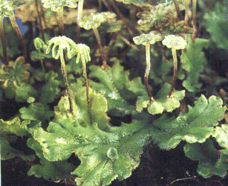
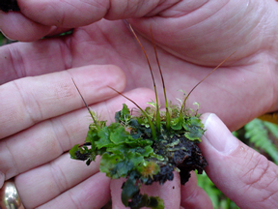
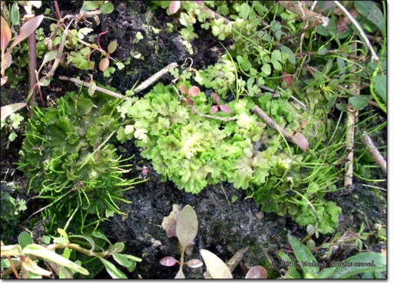
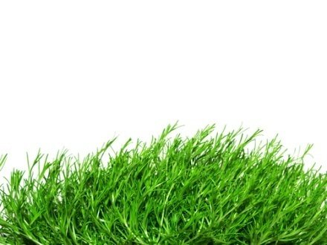

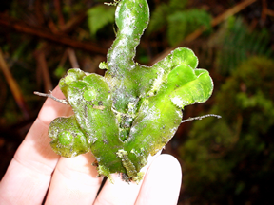
Bryophytes
Mosses, Liverworts and Hornworts:
Require > moisture for life functions
Nonvascular plants – no true roots or leaves
Small, low growing plants that lack vascular tissue
Difficult to transport plant materials throughout the plant
Difficult to support plant – only the rigid cell walls
Reproduce w/ spores & require H₂O to transfer sperm to eggs for fertilization
Hornworts
Moss
Liverworts

Slide 18
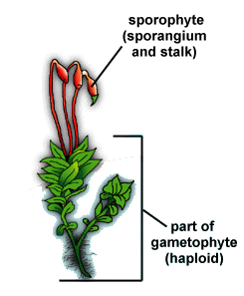
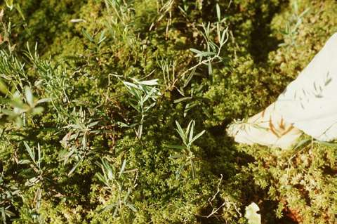
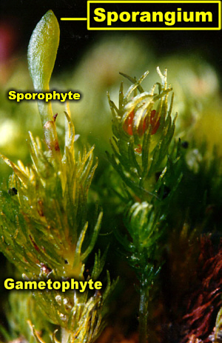
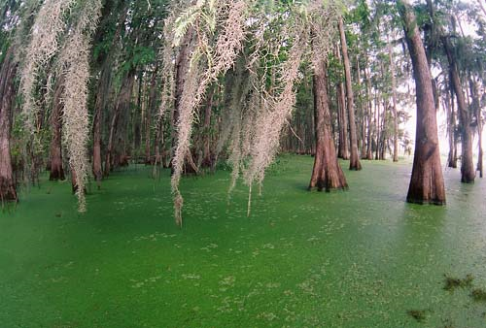
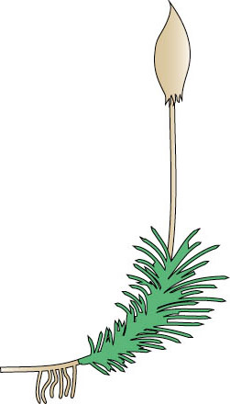
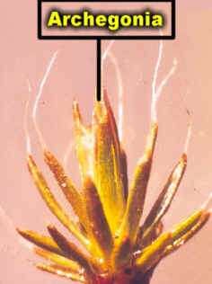
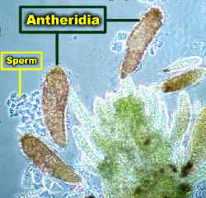
Bryophyte Structure
Moss structure
Sporophyte
Gametophyte
Seta (stalk)
Leaf
Capsule
Rhizoids
Antheridium
Archegonia
Spores
Sphagnum Moss
Typical Moss
Types of Mosses…
Spanish Moss

Slide 19
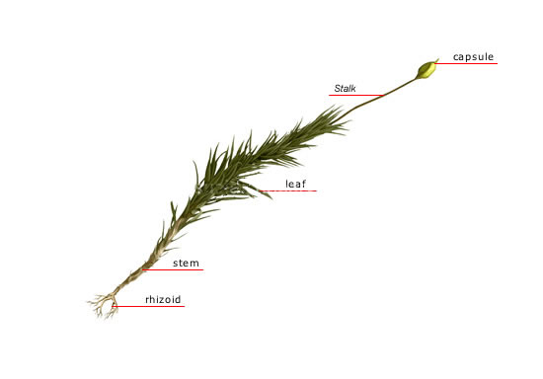
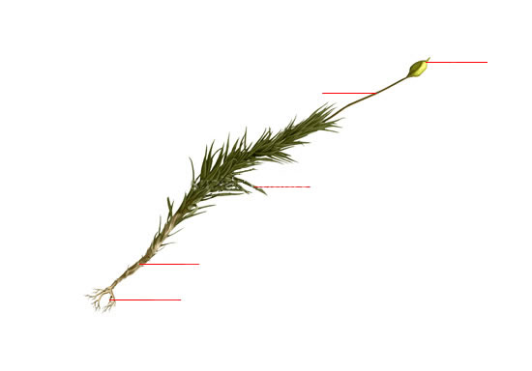
Typical Bryophyte Structure
Try and identify the blanks…
you’ll need to know these for the exam & also to fill out the worksheet

Slide 20
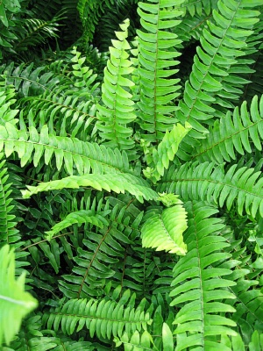
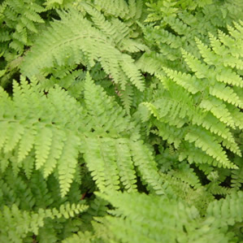
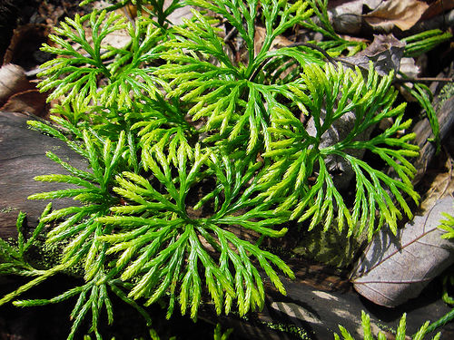




Primitive Tracheophytes
Ferns, Club “Mosses” & Horsetails
Ferns have a vascular system
Use spores to reproduce – do not produce seeds; need H₂O to transfer sperm to egg
Stems are usually horizontal and fronds sprout above the surface
Spores produced on tips of the frond leaflets
Lace Fern
Boston Fern
Types of Primitive Tracheophytes…
Club “Moss”
Water Horsetail
Club “Moss”
Painted Fern
Water Horsetail

Slide 21




Typical Fern Structure
We’ll use a fern to demonstrate the structure of the primitive Tracheophytes
Structures:
Frond
Blade
Petiole
Rhizome
Roots
Fiddlehead
Pinna
Sorus
Sporangium
Archegonium
Antheridium
Sporophyte
Gametophyte
Sorus
Try and identify the blanks
you’ll need to know these for the exam & also to fill out the worksheet

Slide 22

Life Cycle of the Ferns

Slide 23


Another diagram: Fern Life Cycle
Try and identify the letters A-J
you’ll need to know these for the exam & also to fill out the worksheet

Slide 24
That’s enough… Let’s call it a night

